Slide 1


Status Report Efficiencies, Purities and Variable distributions NTUA
Giannis Papakrivopoulos
George Bakas

Slide 2
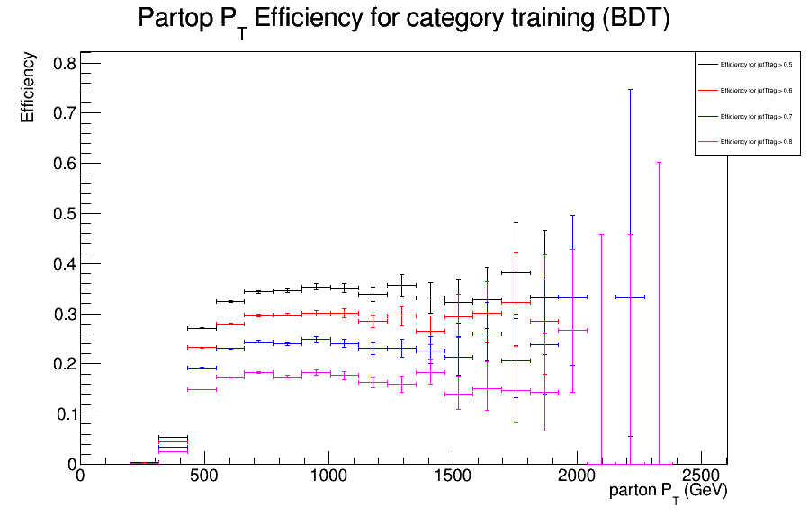
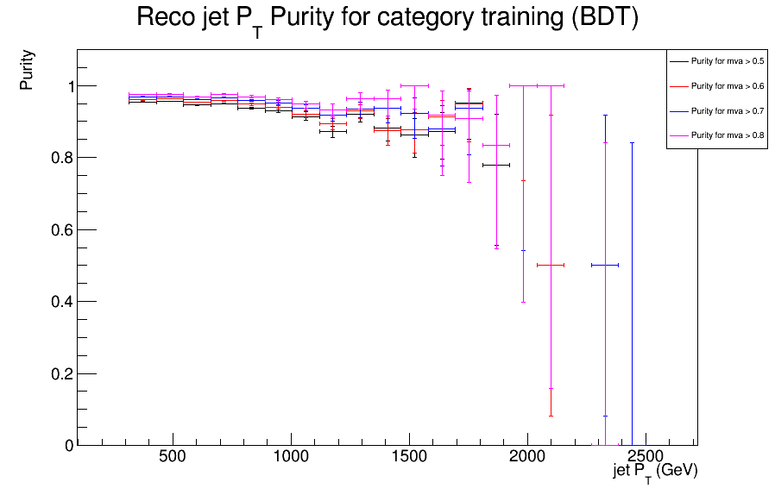
Efficiency and Purity for BDT

Slide 3
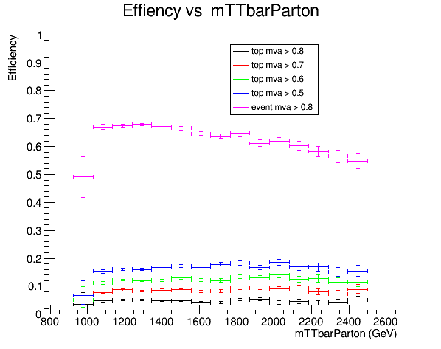
Efficiency vs mTTbarParton
Cuts:
nJets > 1
|parton Eta| < 2.5
partonPt > 500 (both partons)
mTTbarParton > 1000
Subleading jetPt > 400
Event mva > 0.8
Both jets mva > mvaCut
Genika de mas fainetai kalo. Skeftikame pws isws me extra offline cuts px me to b-tagging isws na sumfwnoune perissotero alla den kseroume ti akribws na koitaksoume. Epishs dokimasame na allaksoume to condition wste na katalaboume se poia events einai perissotero efficient. Eidame (kseroume oti auto den einai to requirement) pws otan allaksoume to condition kai anti gia 2 top tagged jets zhthsoume toulaxiston 1 tote to efficiency veltiwnetai arketa (next slide).

Slide 4
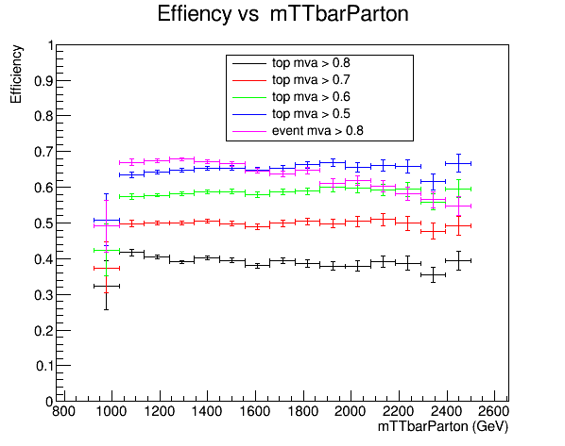
Efficiency vs mTTbarParton
Events with one or more topTagged jets

